Slide 1
Machine Learning Episode #1
THE conjuring code
Vishal

Slide 2
Can machines think?

Slide 3



Hi who is it ?
Hey I am Albert
Notes:
Talk about mars mission and importance of ML

Slide 4






Inspiration : Humans
Machine Learning
Computer Vision
Natural Language Processing

Slide 5
Let’s Code it up

Slide 6
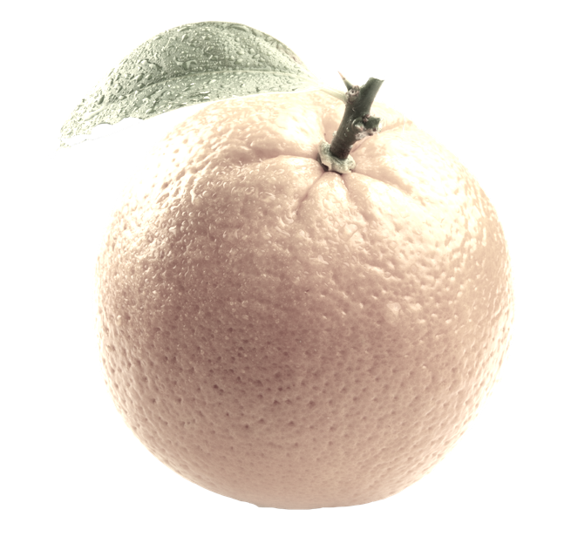
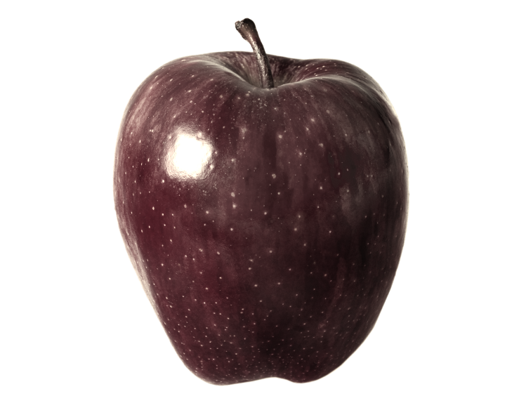
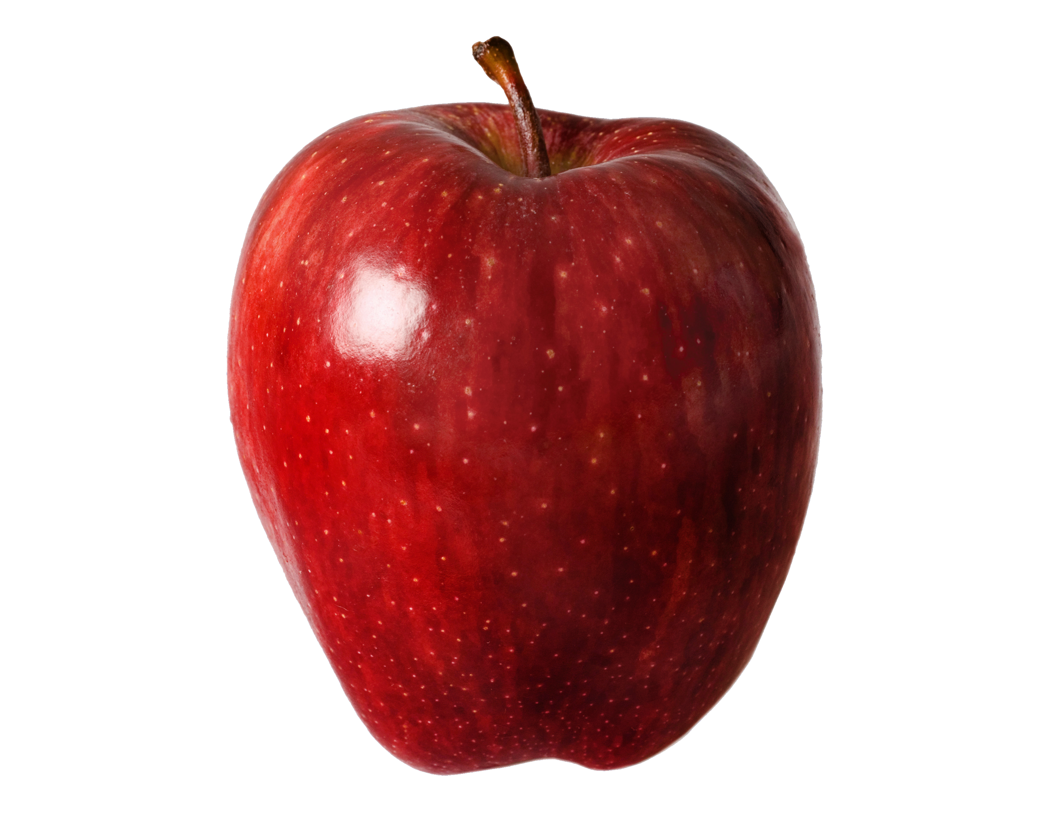

Slide 7
Tools for casting spells
Python
Sci-Kit Learn
Tensor Flow
NumPy

Slide 8
Supervised Learning
Collect Training Data
Train Classifier
Make Predictions

Slide 9
Training Data
Weight | Texture | Label
150g | Bumpy | Orange
170g | Bumpy | Orange
140g | Smooth | Apple
110g | Smooth | Apple

Slide 10
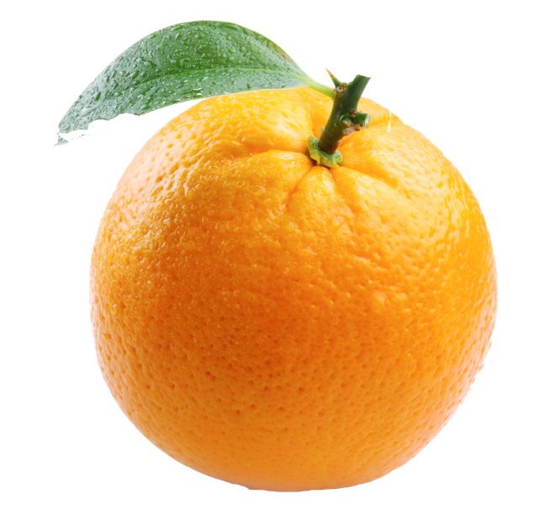

Decision Tree
WEIGHT > 150g
YES
NO
TEXTURE == BUMPY?
YES
NO

Slide 11
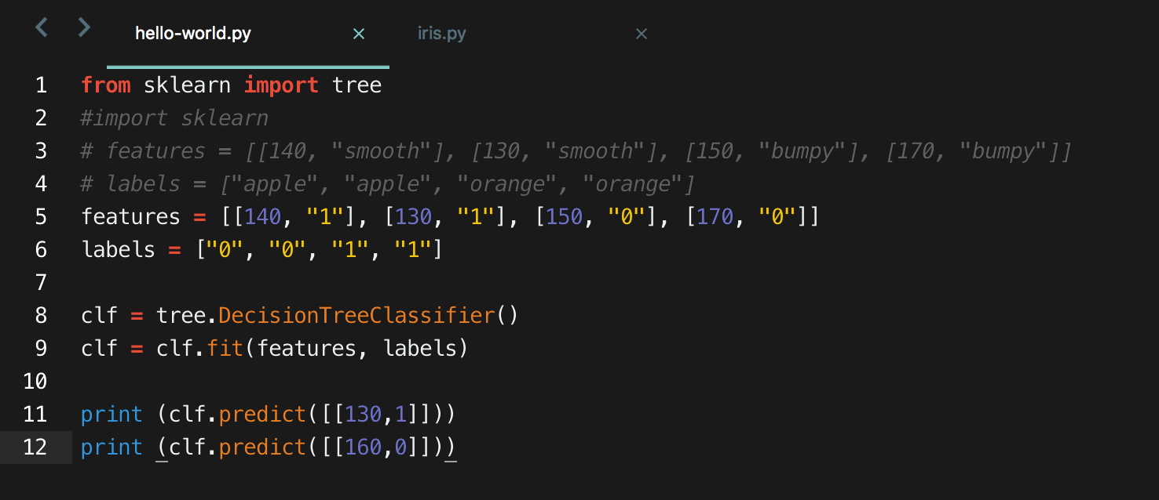

Slide 12
Iris - The classical problem

Slide 13
Goals
Import a dataset
Train a classifier
Predict label for new flower
Visualize the tree

Slide 14
Testing Data
Examples used to “test “ the classifier ‘s accuracy
Not part of training data

Slide 16
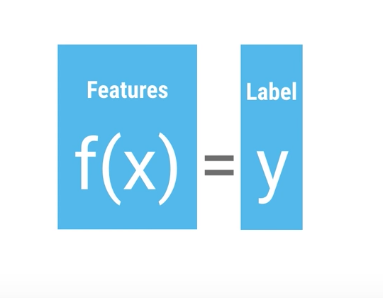
Pipeline
At high level, classifiers are functions
Classifier Accuracy

Slide 17
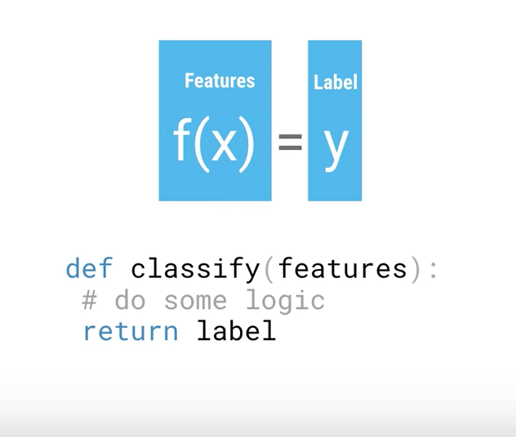

Slide 18
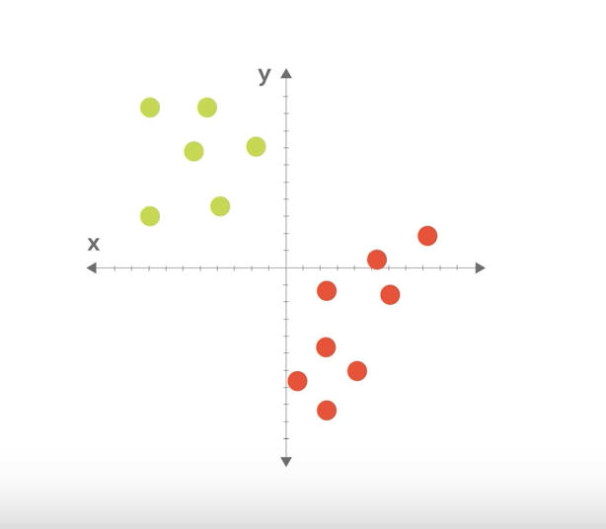
Models
Notes:
Draw a line
Start with random line
Then move as per test data
Tensorflow playground
http://playground.tensorflow.org/

Slide 19
What next ?
Writing our own classifiers
More complex data analysis
Graph plotting
Identifying handwritten digits
Identifying text (Natural Language Processing)
Image Classifier (Tensorflow for poets)

